Slide 1
Introduction to Chronicle
Micro second latency persistence
Higher Frequency Trading
(c) Peter Lawrey

Slide 2

What is Chronicle?
Very fast embedded persistence for Java.
Functionality is simple and low level by design

Slide 3

Where does Chronicle come from
Low latency, high frequency trading
  Applications which are sub 100 micro-second external to the system.

Slide 4
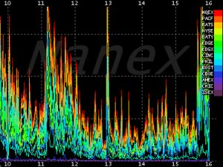
Where does Chronicle come from
High throughput trading systems
  Hundreds of thousand of events per second

Slide 5

Where does Chronicle come from
Modes of use
  GC free
  Lock-less
  Shared memory
  Text or binary
  Replicated over TCP

Slide 6
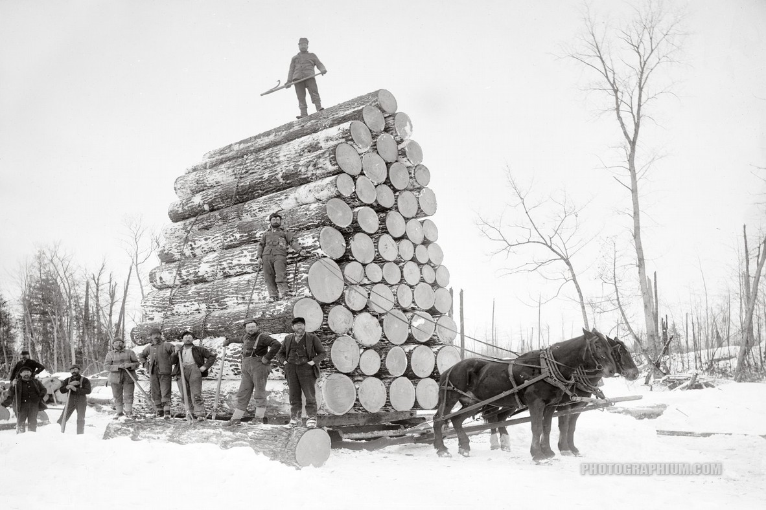
Use for Chronicle
Synchronous text logging
Synchronous binary data logging

Slide 7

Use for Chronicle
Messaging between processes
via shared memory
Messaging across systems

Slide 8
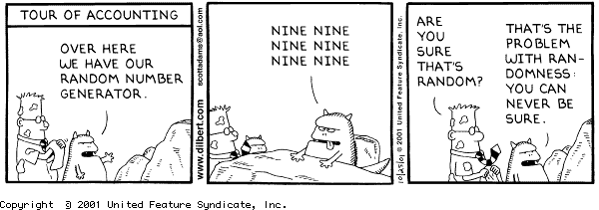
Use for Chronicle
Supports recording micro-second timestamps across the systems
Replay for production data in test

Slide 9
Writing to Chronicle
Chronicle ic = new IndexedChronicle(basePath);
Excerpt excerpt = ic.createExcerpt();
for (int i = 0; i < 1000000; i++) {
excerpt.startExcerpt(16);
excerpt.writeLong(i); // e.g. time stamp
excerpt.writeDouble(i);
excerpt.finish();
}
ic.close();

Slide 10
Reading from Chronicle
Chronicle ic = new IndexedChronicle(basePath);
Excerpt excerpt = ic.createExcerpt();
while(excerpt.nextIndex()) {
long l = excerpt.readLong(i);
double d = excerpt.readDouble(i);
// check l and d are correct
excerpt.finish();
}
ic.close();

Slide 11

How does it perform
On an i5 laptop with a mobile HDD
Messages | Write and read
1 million | 0.47 seconds
10 million | 4.3 seconds
100 million | 53 seconds
200 million | 308 seconds

Slide 12

How does it recover?
Once finish() returns, the OS will do the rest.
If an excerpt is incomplete, it will be pruned.

Slide 13
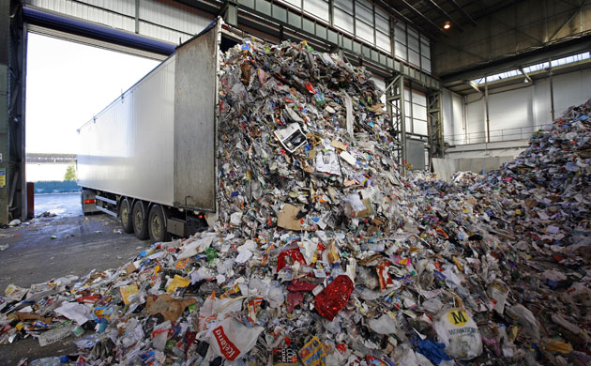
How does it collect garbage?
There is an assumption that your application has a daily or weekly maintenance cycle.
This is implemented by closing the files and creating new ones. i.e. the whole lot is moved, compressed or deleted.
Anything which must be retained can be copied to the new Chronicle

Slide 14
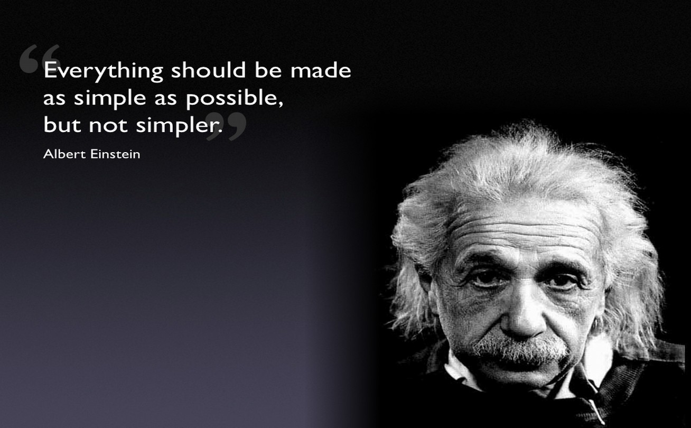
Is there a higher level API?
You can hide the low level details with an interface.

Slide 15
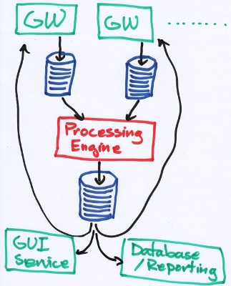
Is there a higher level API?
There is a demo program with a simple interface.
This models a “hub” process which take in events, processes them and publishes results.

Slide 16
Is there a higher level API?
The interfaces look like this
public interface Gw2PeEvents {
public void small(MetaData metaData, SmallCommand command);
}
public interface Pe2GwEvents {
public void report(MetaData metaData, SmallReport smallReport);
}
On this laptop, it performs around 400K msg/s
in and out, persisted.

Slide 17

What does Chronicle need
More documentation
More tutorials
More use case examples

Slide 18
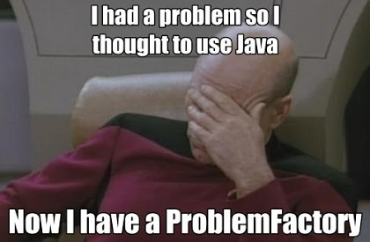
What is planned
Make it easier to use
Text logging support
Low latency XML and FIX parser and writer

Slide 19

Q & A

